Slide 1

NATIONAL INSTITUTE OF TECHNOLOGY
MIZORAM
WECHAT-A FLUTTER APPLICATION
UNDER THE GUIDANCE OF:
Dr. Lenin Laitonjam
BY:
BADDALA SAI KUMAR REDDY
BT19CS006
DEPARTMENT OF COMPUTER SCIENCE AND ENGINEERING

Slide 2
CONTENTS
Project Overview
Existing System
Proposed System
Modules
Use Case Diagram
ER Diagram
Technology Overview
App Features
Application Snapshots
Learning From The Project
Conclusion
Future Scope
References

Slide 3
PROJECT OVERVIEW
WeChat is a chatting app which is created by using Flutter.
Chat refers to the process of communicating,interacting and exchanging message over the internet.It involves two or more individuals that communicate through a chat enabled service or software.Chat may be delivered through text,audio or video communication via the internet.
A chat application has two basic components:Server and Client.
A server is a computer program or a device that provides functionality for other programs or devices.
A client who want to chat with each other connect to the server
The WeChat application is more like a Chat Room,rather than a peer to peer chat.So this means multiple users can connect to the chat server and send their messages.Every message is broadcasted to every other connected chat user of the same channel.

Slide 4
EXISTING SYSTEM
In chatting applications we have many features. Keep in touch with the groups of people that matter the most, like your family WhatsApp on the web and desktop, you can seamlessly sync all of your chats to your computer so that you can chat on whatever device is most convenient for you. WhatsApp voice and video calls use your phone's Internet connection, instead of your cell plan's voice minutes, so you don't have to worry about expensive calling charges. Send PDFs, documents, spreadsheets, slideshows and more, without the hassle of email or file sharing apps. Sometimes, your voice says it all. With just one tap you can record a Voice Message, perfect for a quick hello or a longer story.

Slide 5
PROPOSED SYSTEM
The proposed system is the computerized version of the existing system. This app includes some new features like chatbot, scheduling a message, location tracking,news page and music page. A chatbot or chatterbot is a software application used to conduct an online chat conversation via text or text-to-speech, in lieu of providing direct contact with a live human agent. Users can checkout latest news based on their interests and can annotate the highlights which then will be notified to the other users in the channel. Any member in a channel will be able to pin a note on to the channel header so that it can be opened by any other member in the channel.

Slide 6
Modules
The project “WeChat” deals with the following main modules.
Onboarding Page
This page showcases the features of the app.
Login Page
This page is used to get the phone number from user.
Message Page
This is the page where the user chat with their friends.
Create Channel Page
This is the page where user can create group for chatting.
Join Channel Page
This page is used to join a channel using QR- code or by using channel ID.

Slide 7
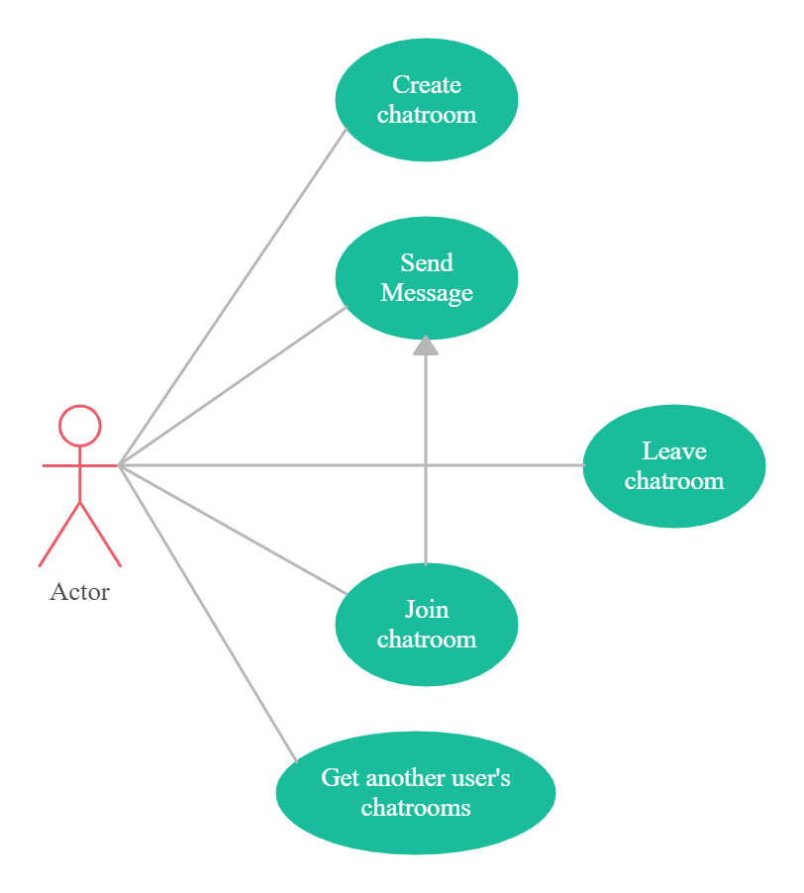
USE CASE DIAGRAM

Slide 8
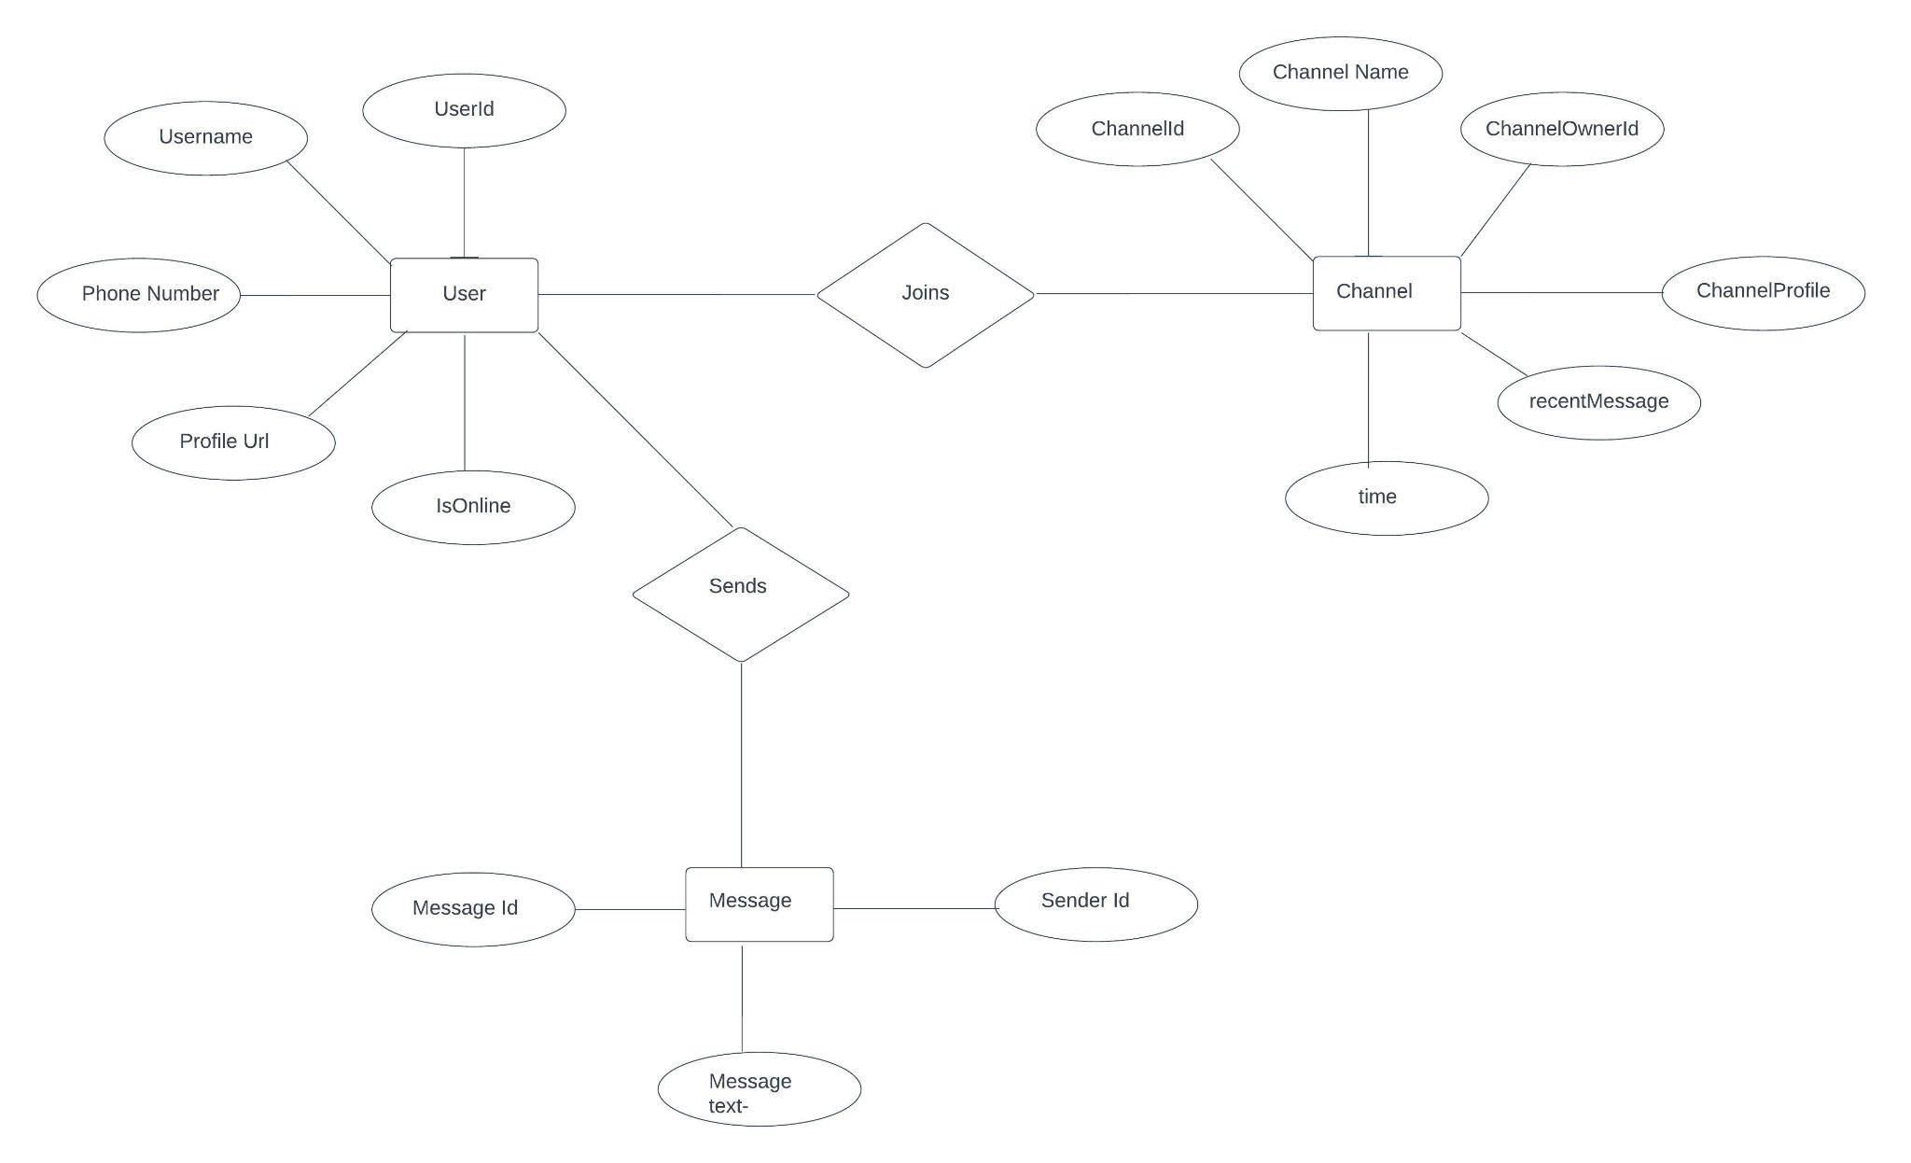
ER DIAGRAM

Slide 9
TECHNOLOGY OVERVIEW
Frontend Framework used: Flutter
Programming Language used: Dart
Backend: Firebase
Ide used: Visual Studio Code
The app runs on any platform such as Android,ios,Linux,windows.

Slide 10
Frontend
The frontend framework that is used in this application is Flutter.
Flutter is an open-source UI software development kit created by google.It is used to develop cross platform applications for android,ios,Linux,macOS,windows and the web from a single codebase.
Flutter is a simple and high performance framework based on dart language,which provides high performance by rendering the UI directly in the operating system’s canvas rather than through native framework.
To be specific,a flutter application is itself a widget.Flutter widgets also supports animations and gestures.
Flutter offers many ready to use widgets(UI) to create a modern application.These widgets are optimized for mobile environment and designing the application using widgets is simple as designing HTML.
The application logic is based on reactive programming.
A widget have a state.By changing the state of widget,flutter will automatically (reactive programming) compare the widget’s previous state and render the widget with only the necessary changes instead of re-rendering the whole widget.

Slide 11
WHY FLUTTER?
Modern and reactive framework
Fast development
Uses Dart programming language and it is very easy to learn
Beautiful and fluid user interfaces
Huge predefined widget catalog
Runs same UI for multiple platforms
High performance application

Slide 12
BACKEND
The backend that is used in this application is Firebase.
Cloud Functions for firebase is a serverless framework that lets you automatically run backend code in response to events triggered by firebase features and HTTPS requests.
Cloud Firestore is a flexible,scalable database for mobile,web,and server development from firebase and Google Cloud.
Like Firebase Realtime Database,it keeps your data in sync across client apps through real time listeners and offers offline support for your mobile and web so we can build responsive apps that work regardless of network latency internet connectivity.
There is a Firebase SDK to configure your functions through code.
Integrated with Firebase Console and Firebase CLI.

Slide 13
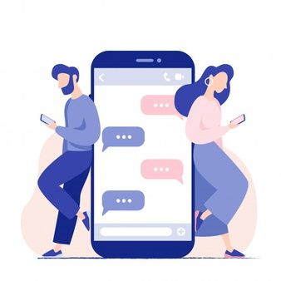


App features
Group chatting
Showing latest news
A user can listen to local music and also can dedicate a song to other member in the channel.
A user can see realtime location of other member in the channel upon his/her consent.

Slide 14
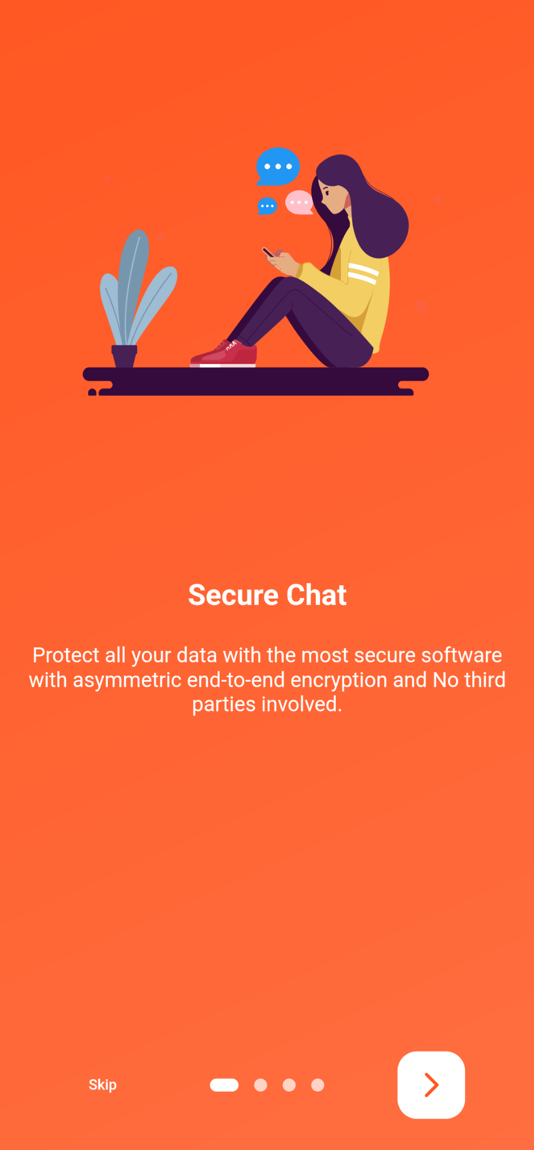
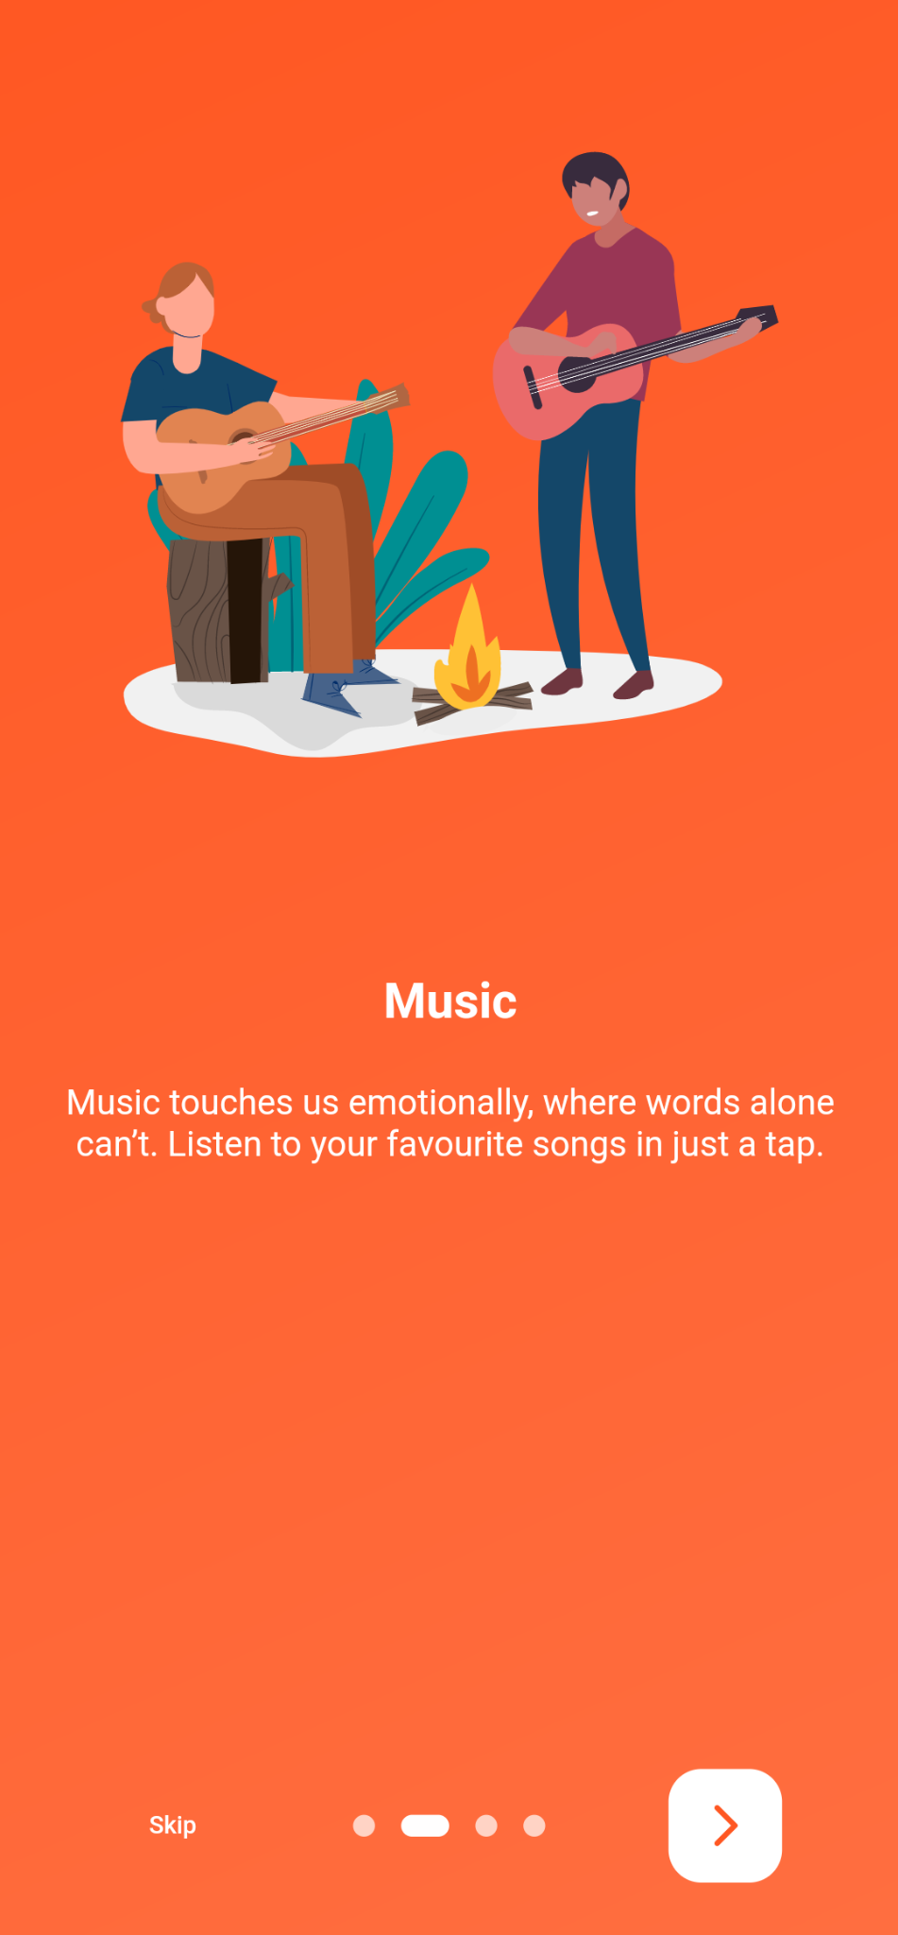
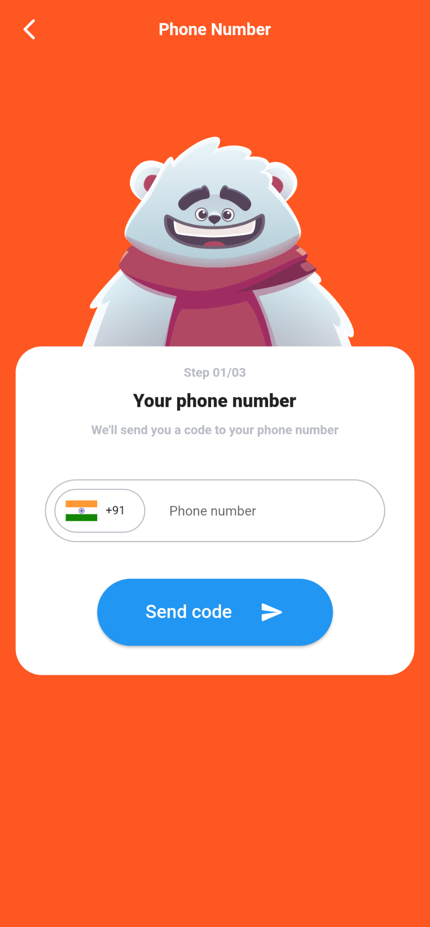
APP SNAPSHOTS
Splash Screen 1
Splash Screen 2
Sign In

Slide 15
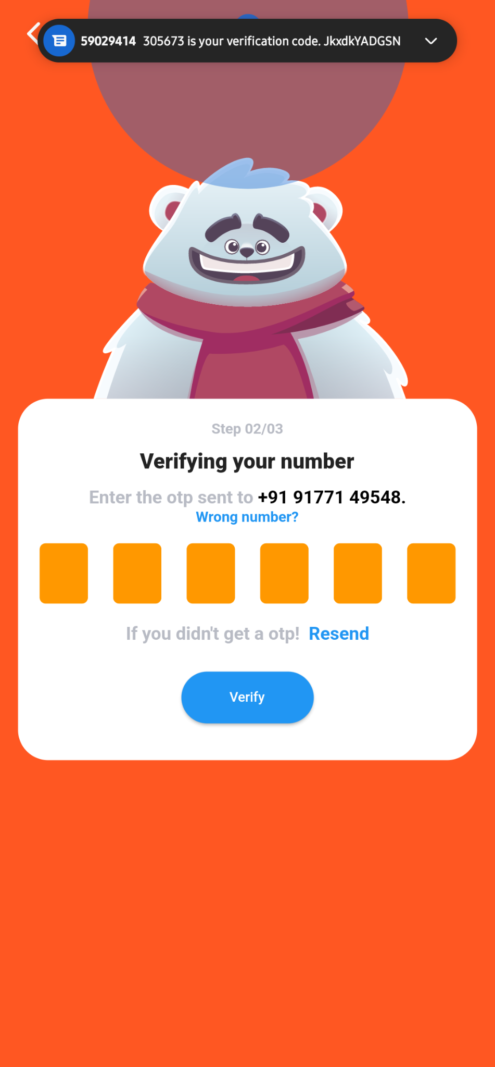
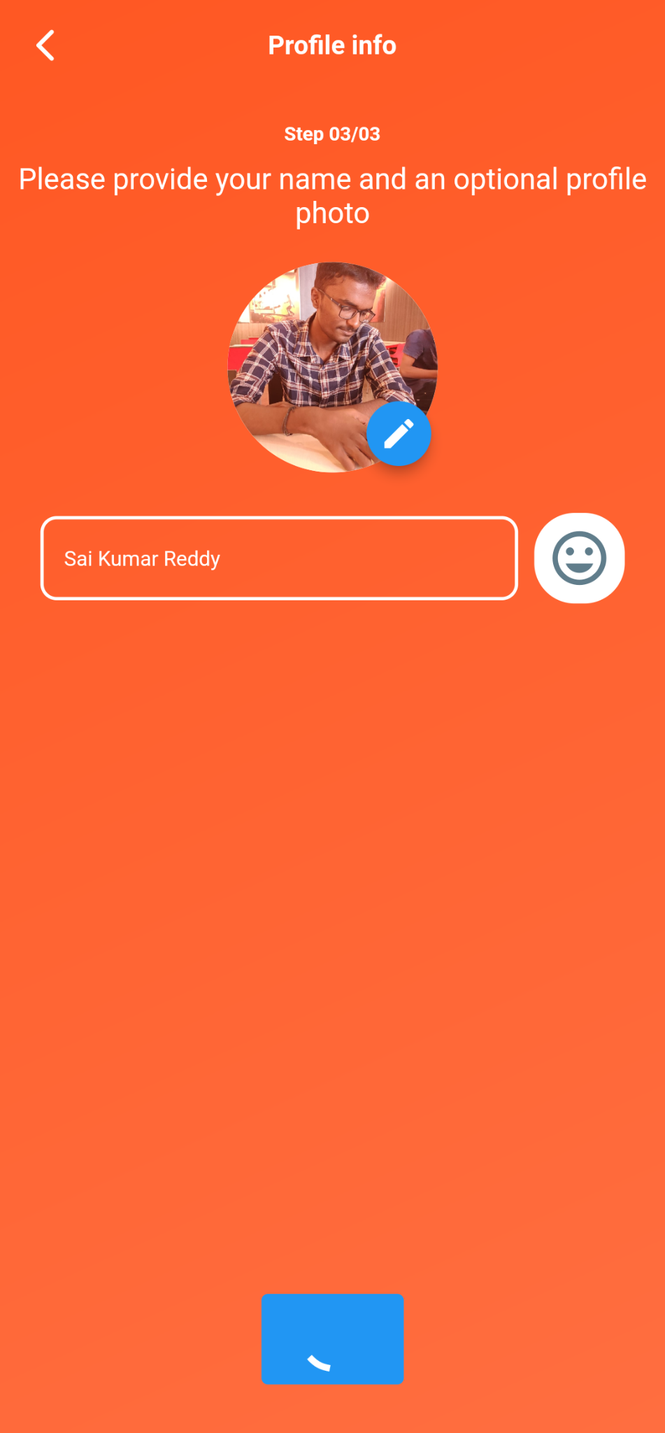
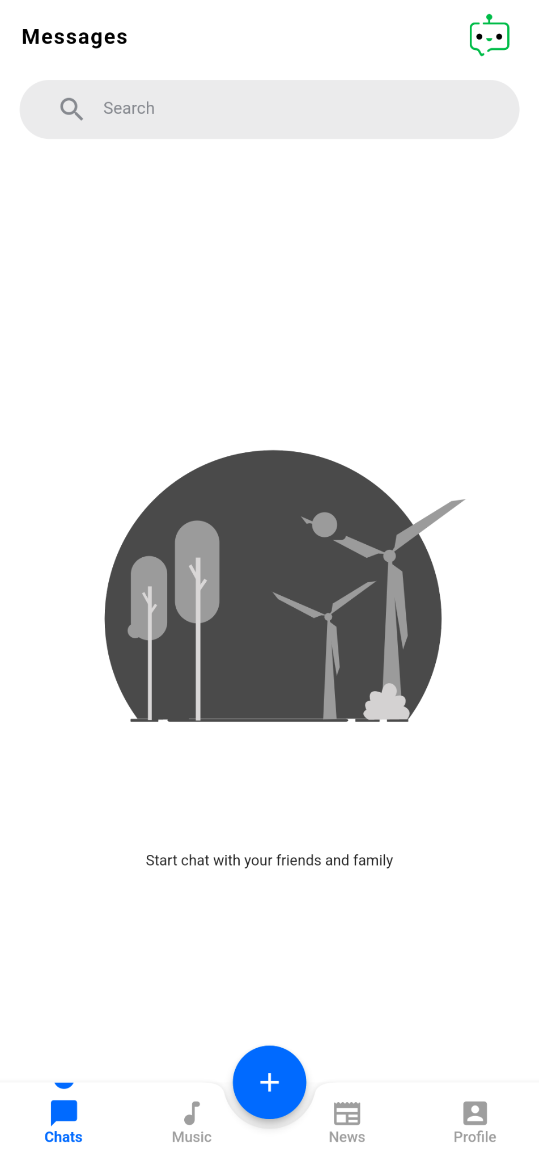
Authentication
Create Profile
Home Page

Slide 16
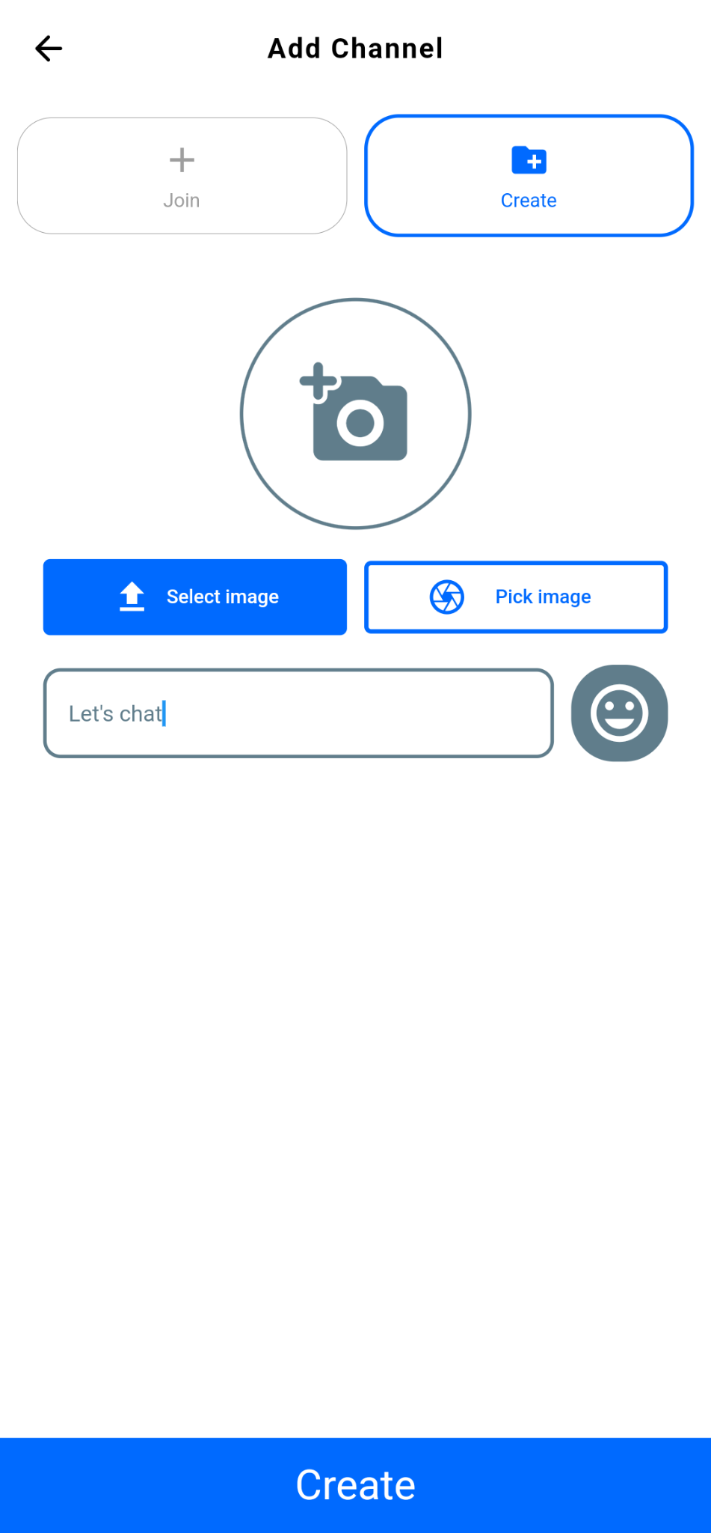
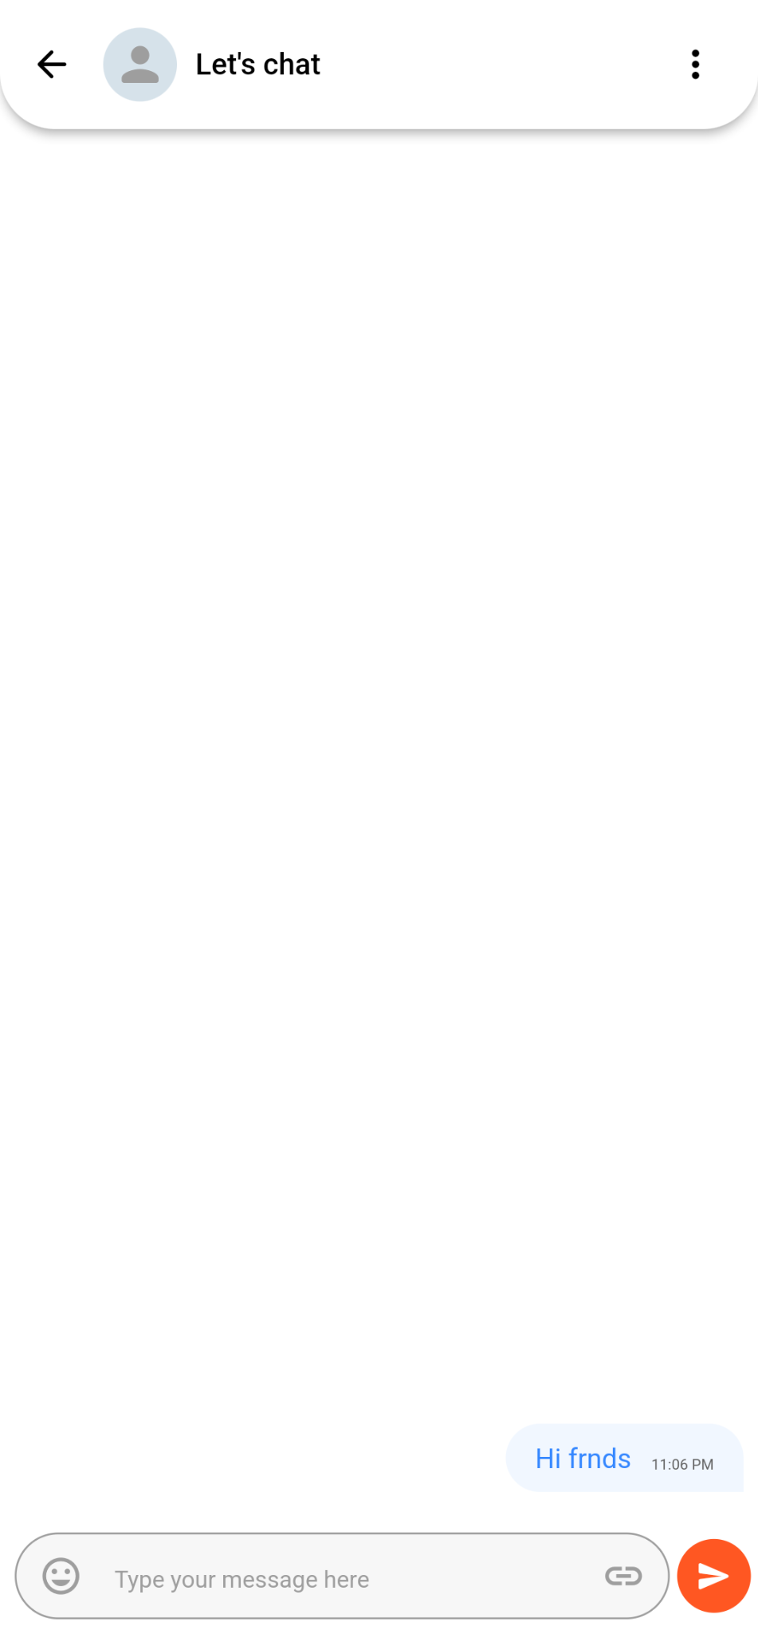
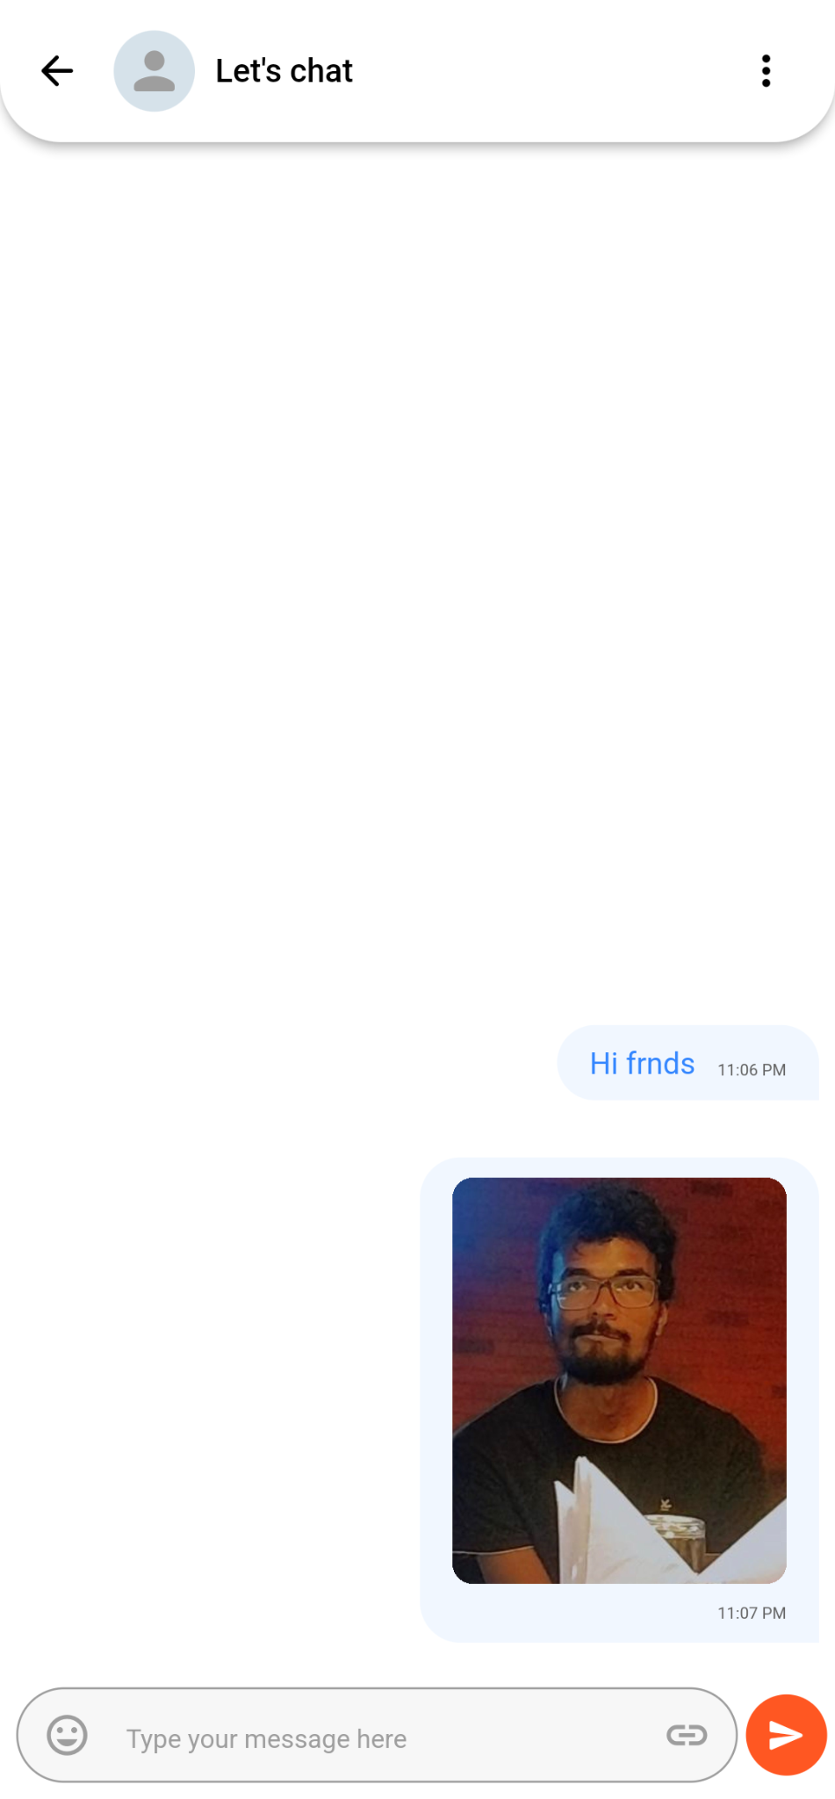
Messaging
Sending Pics
Create Channel

Slide 17
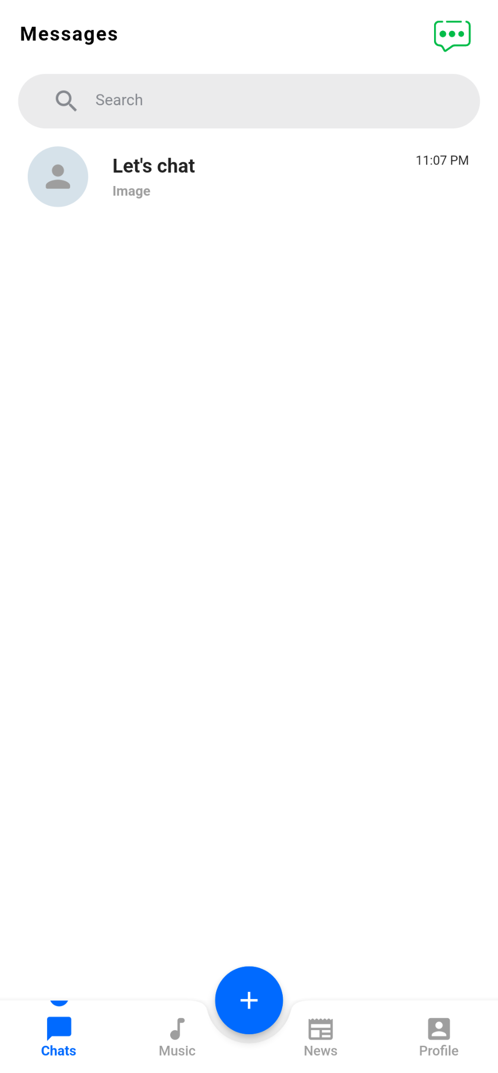
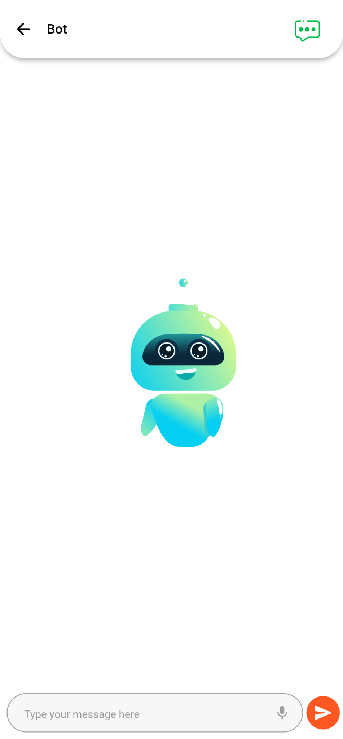
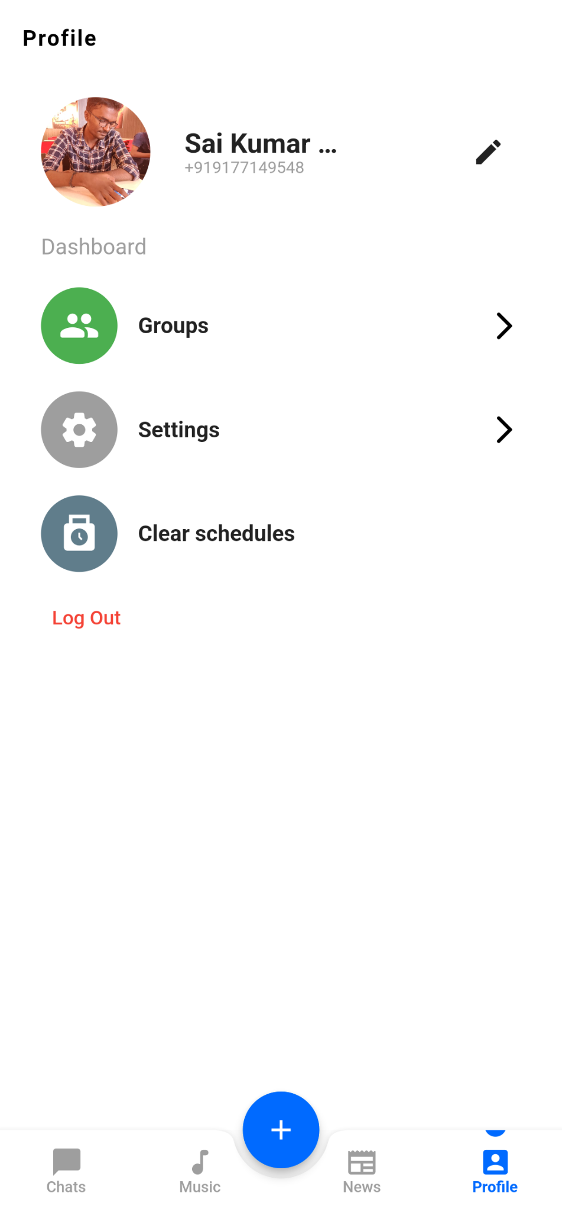
Chat Bot
Profile Page
Channel List

Slide 18
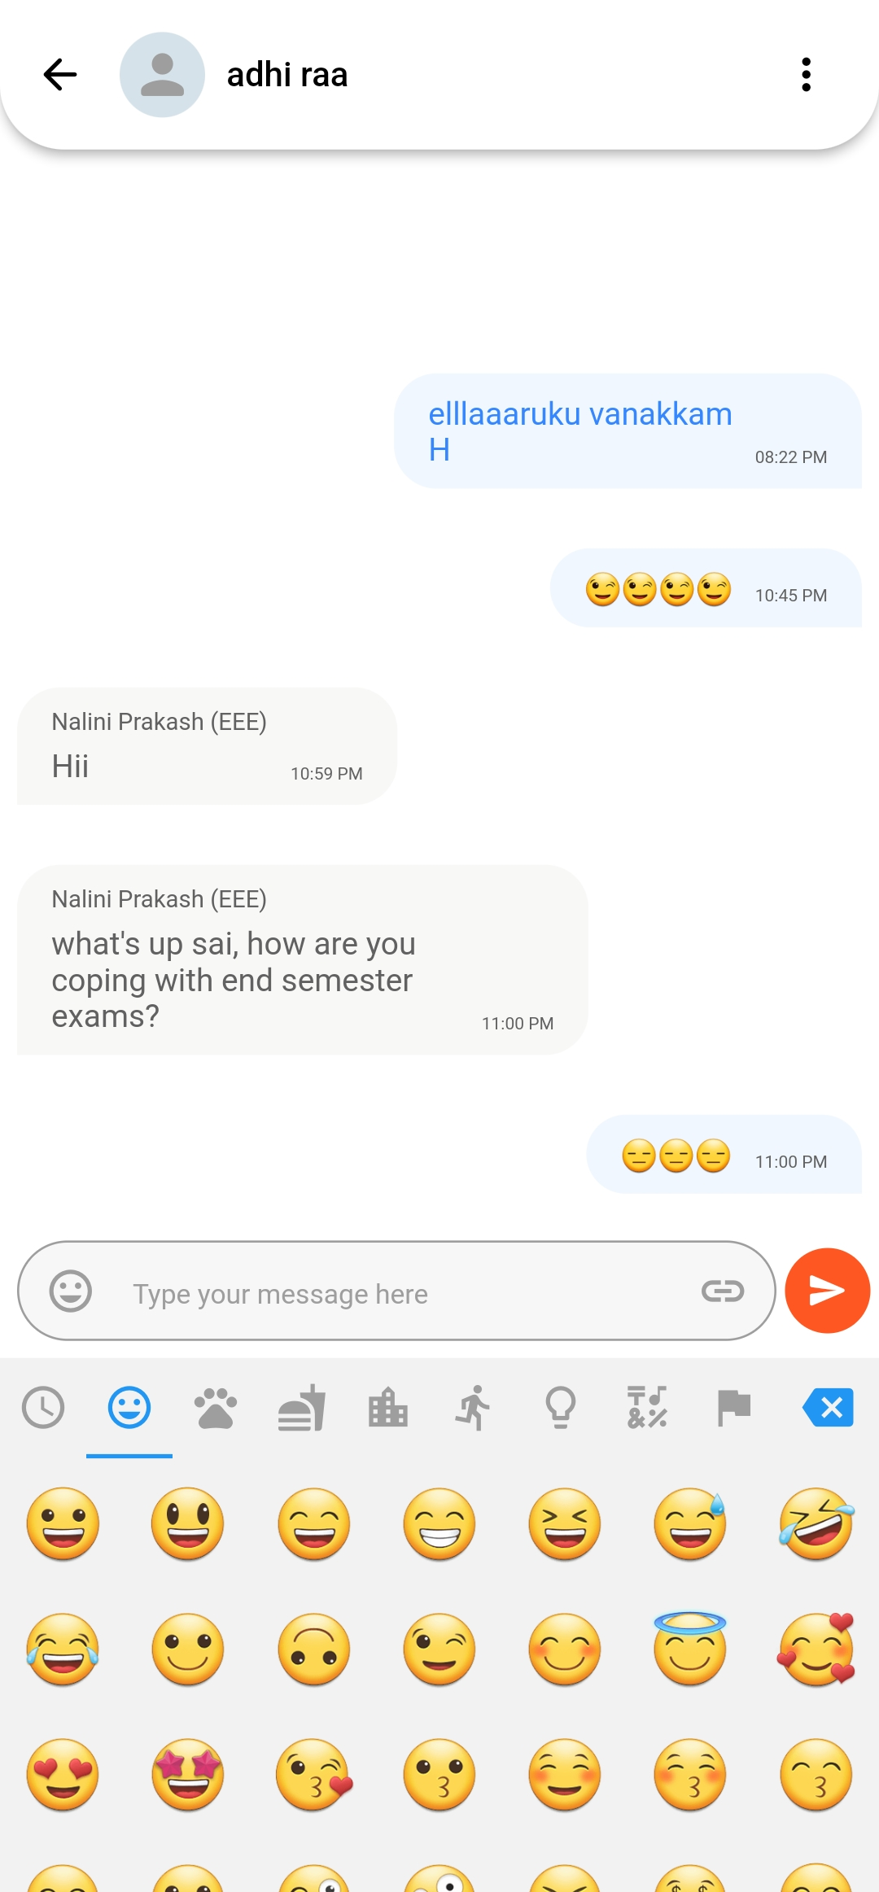
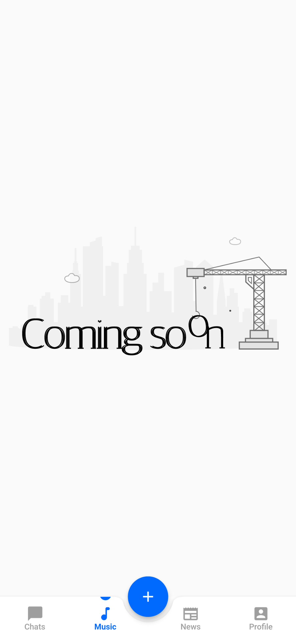
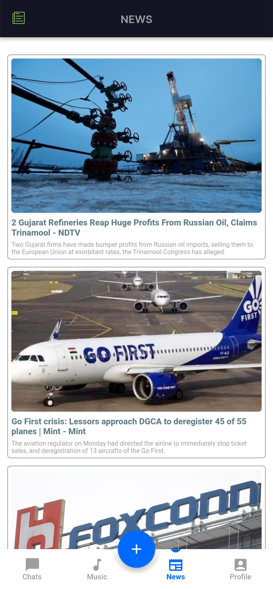
Messaging
Music Page
News Page

Slide 19
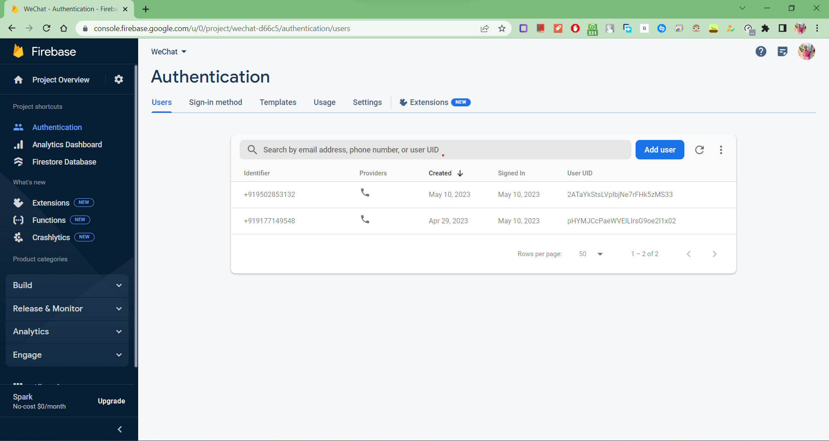
Firebase Console:

Slide 20
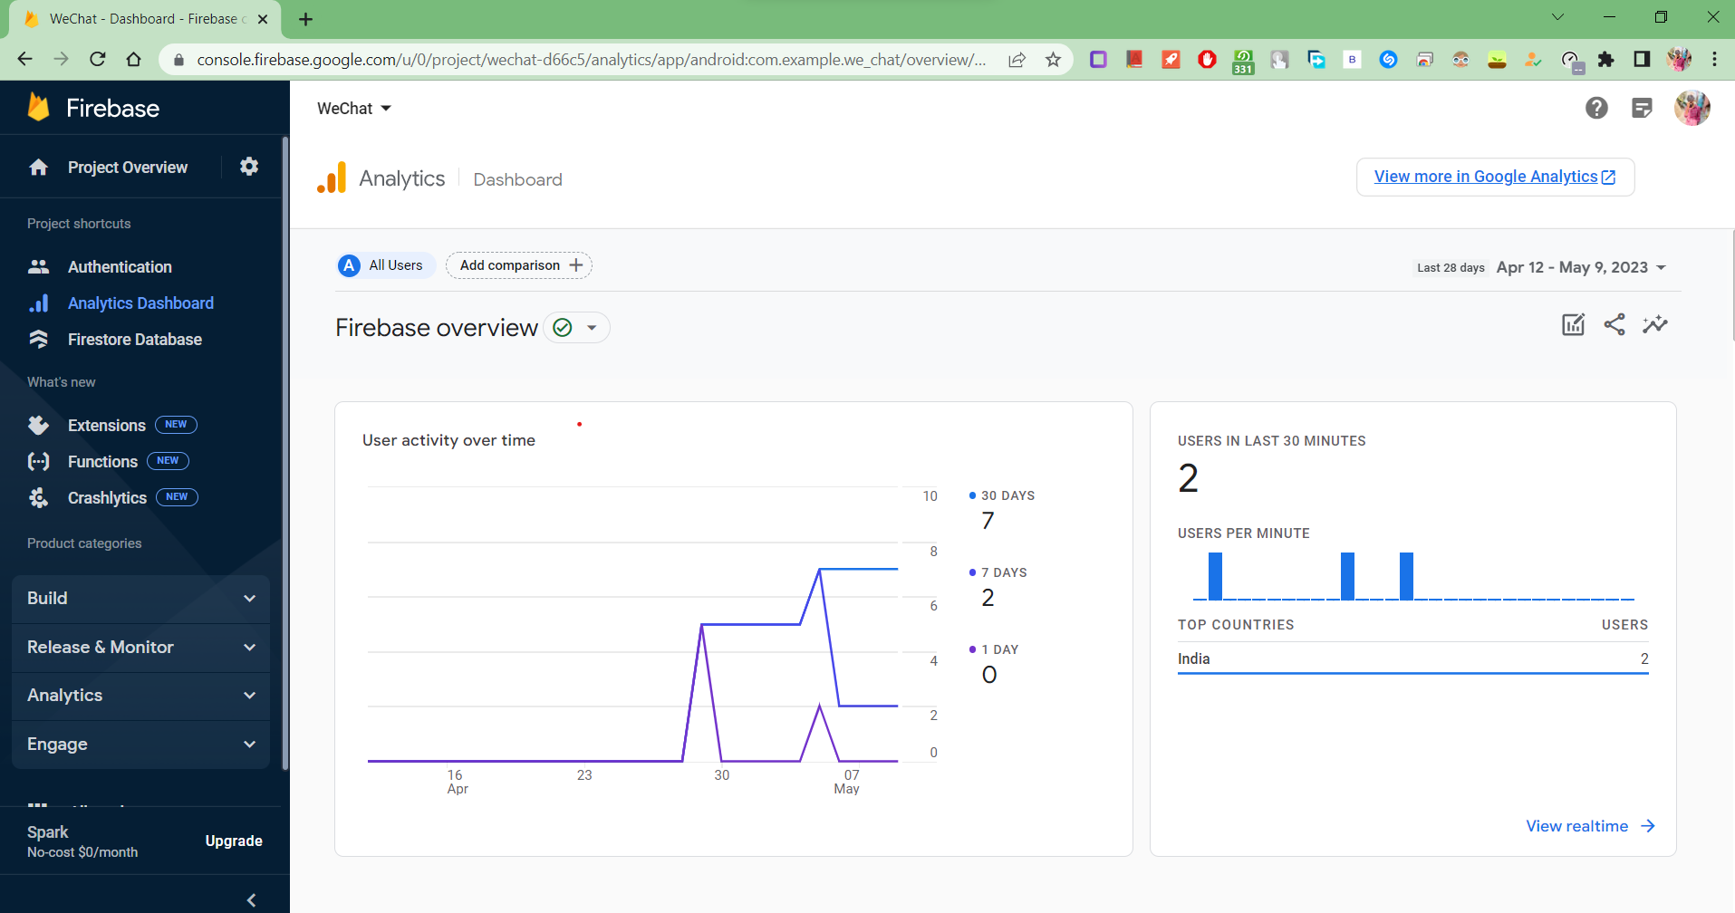

Slide 21
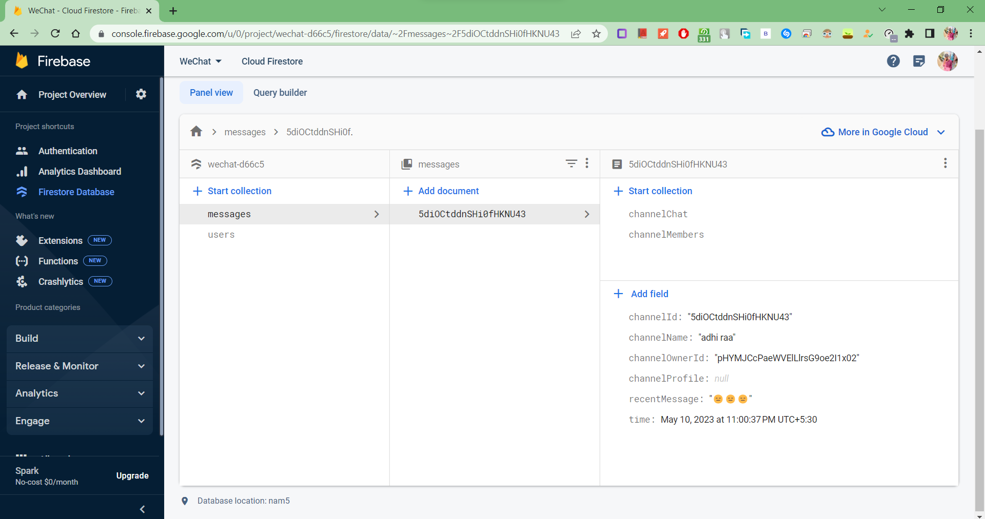

Slide 22
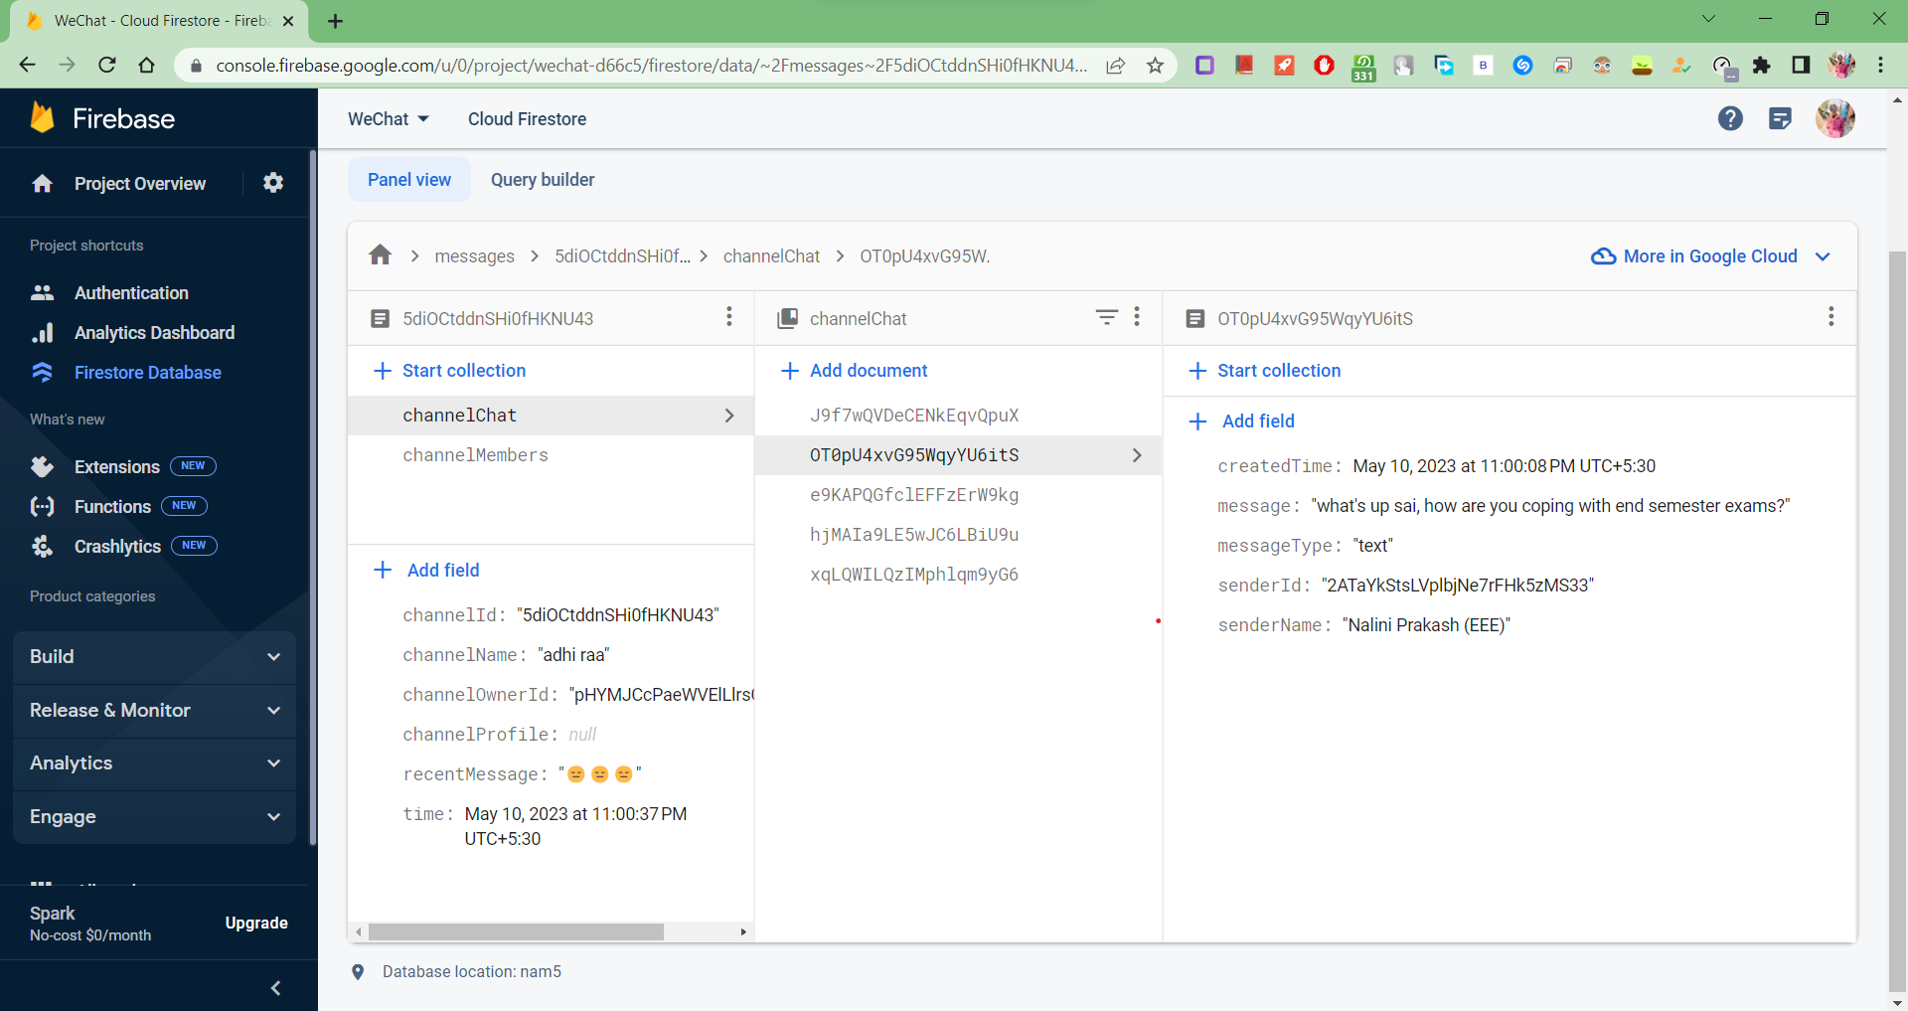

Slide 23
LEARNING FROM THE PROJECT
App development with modern framework Flutter
Familiarity with Visual Studio Code
Hands on experience with Dart programming language
Integrating firebase and firestore to a flutter project
State Management which is required to sync multiple modules between multiple states

Slide 24
CONCLUSION
This application has a user friendly screen that enables the user to use without any inconvenience.Validation checks induced have greatly reduced errors.Provisions have been made to upgrade the application.
Flutter framework does a great job by providing an excellent framework to build mobile applications in a truly platform independent way. By providing simplicity in the development process, high performance in the resulting mobile application, rich and relevant user interface for both Android and iOS platform.
The complete project code can be viewed from my github profile -https://github.com/bunty172/WeChat

Slide 25
FUTURE SCOPE
Local songs will be updated automatically in songs page.
User can dedicate songs to their friends.
Users can checkout latest news based on their interests and can annotate the highlights which then will be notified to the other users in the channel.
An option which will enable the user to send the real time location to other users in the channel.
Any member in a channel will be able to pin a note on to the channel header so that it can be opened by any other member in the channel.

Slide 26
REFERENCES
https://flutter.dev/
https://gallery.flutter.dev/#/
https://dart.dev/
https://firebase.google.com/docs
https://stackoverflow.com/questions/tagged/flutter

Slide 27
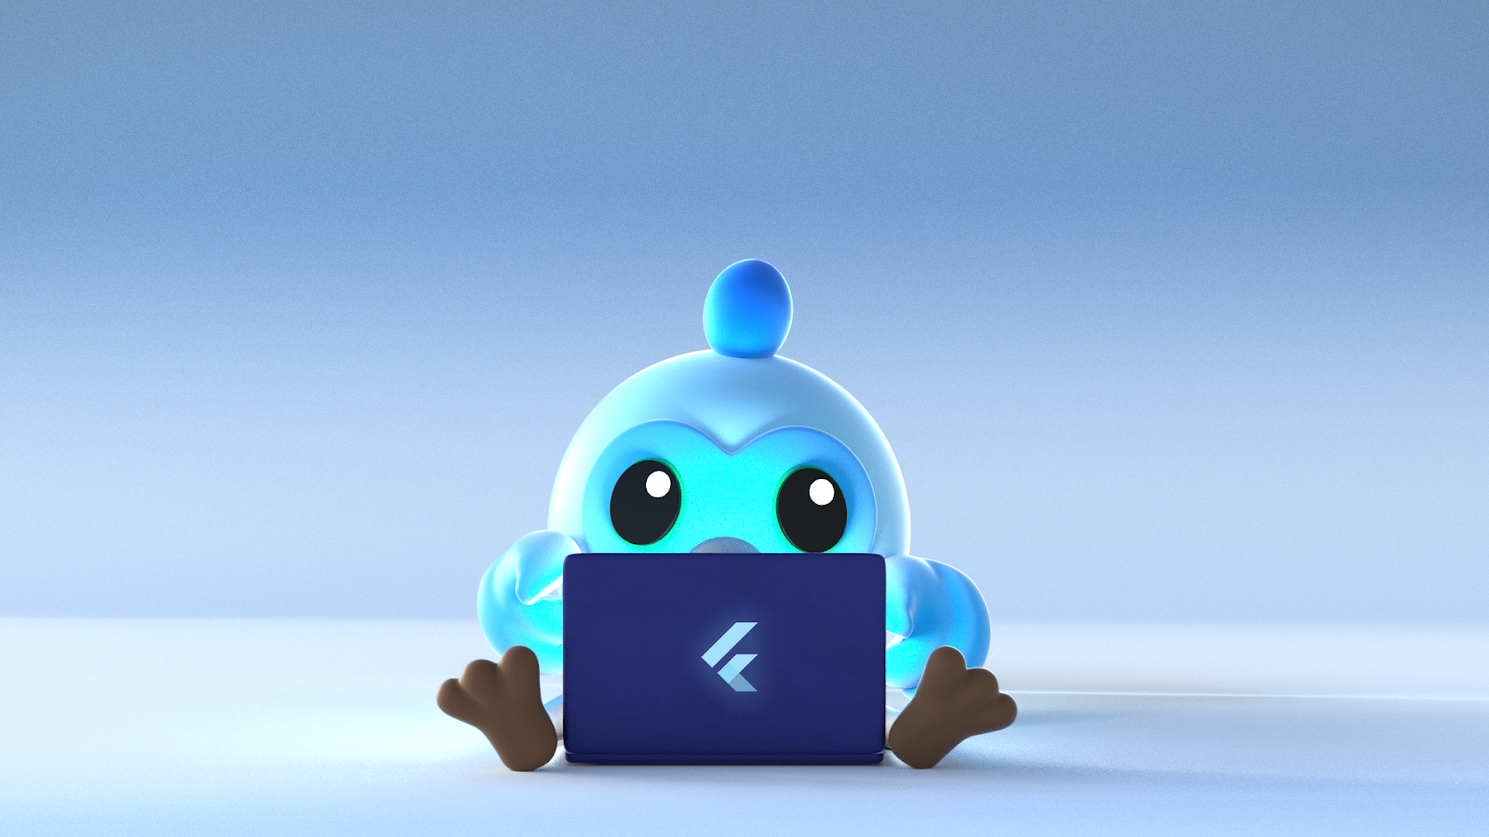
Thank you!

